Slide 1

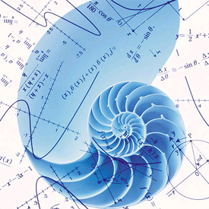
Azərbaycan Dövlət Neft və Sənaye Universiteti
Numerical Methods I

Slide 2

Approximations and
Round$−$Off Errors

Slide 3
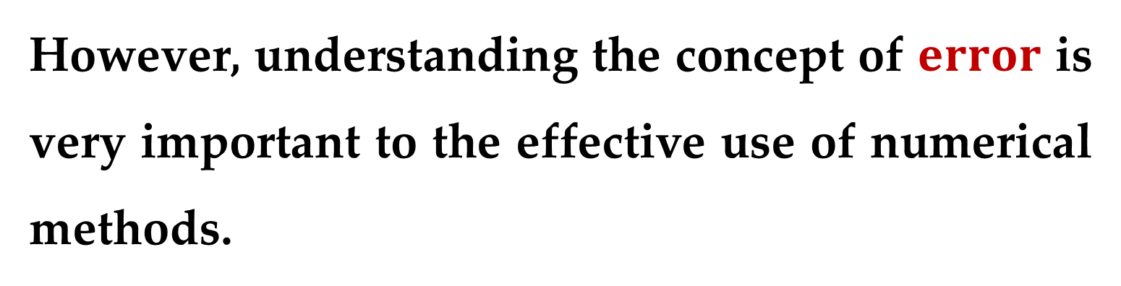
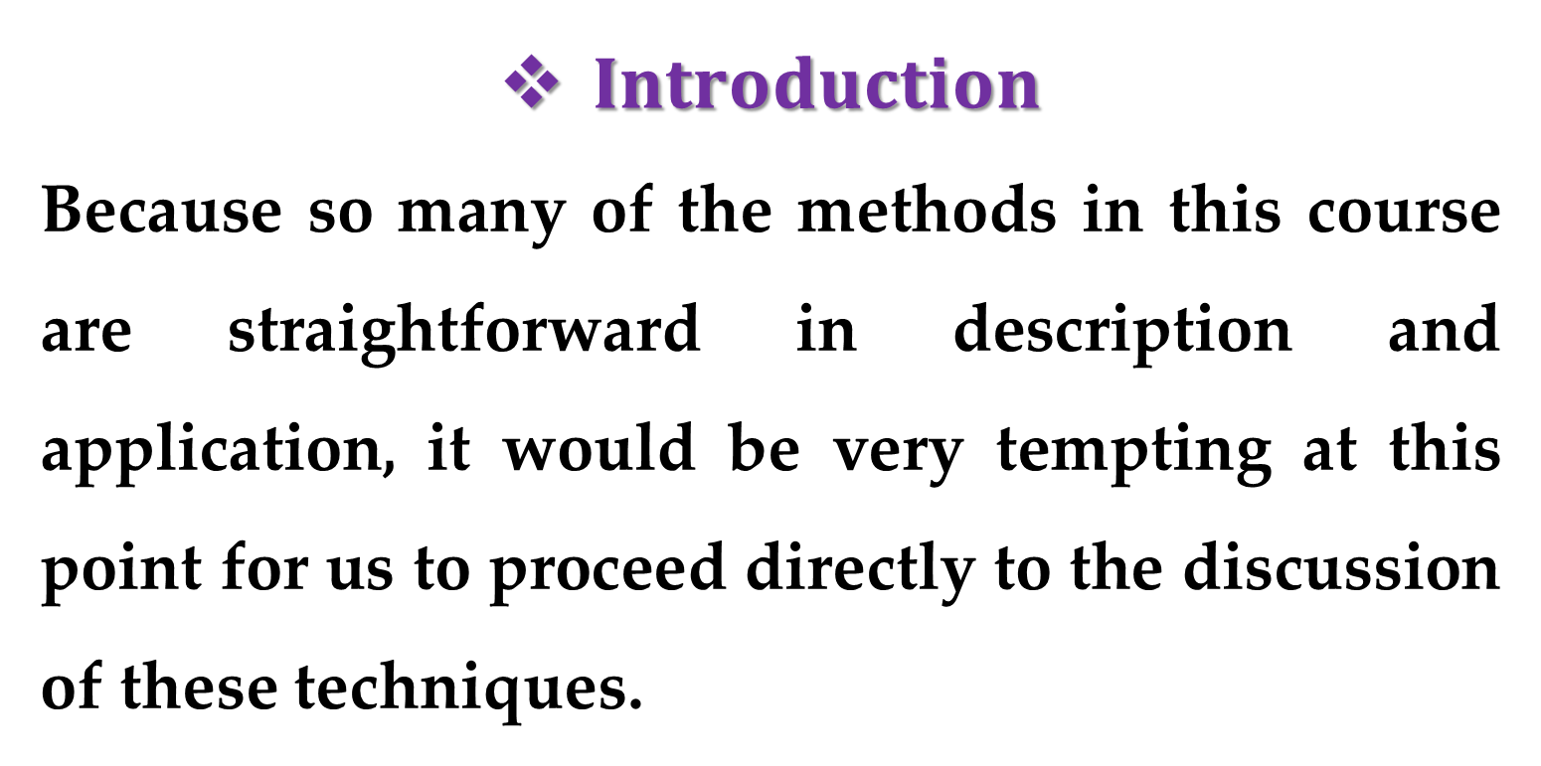
$Introduction$
Because so many of the methods in this course are straightforward in description and application, it would be very tempting at this point for us to proceed directly to the discussion of these techniques.
However, understanding the concept of $error$ is very important to the effective use of numerical methods.

Slide 4
The importance of error can be seen from our previous discussion of the falling parachutist problem.
Recall that we determined the velocity of a falling parachutist by both analytical and numerical methods.

Slide 5
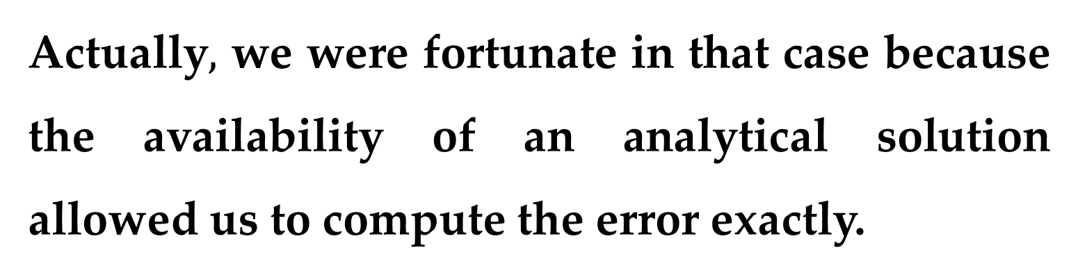
Although the numerical technique yielded estimates that were close to the exact (analytical) solution, there was a discrepancy (error), because the numerical method involved an approximation.
Actually$,$ we were fortunate in that case because the availability of an analytical solution allowed us to compute the error exactly.

Slide 6
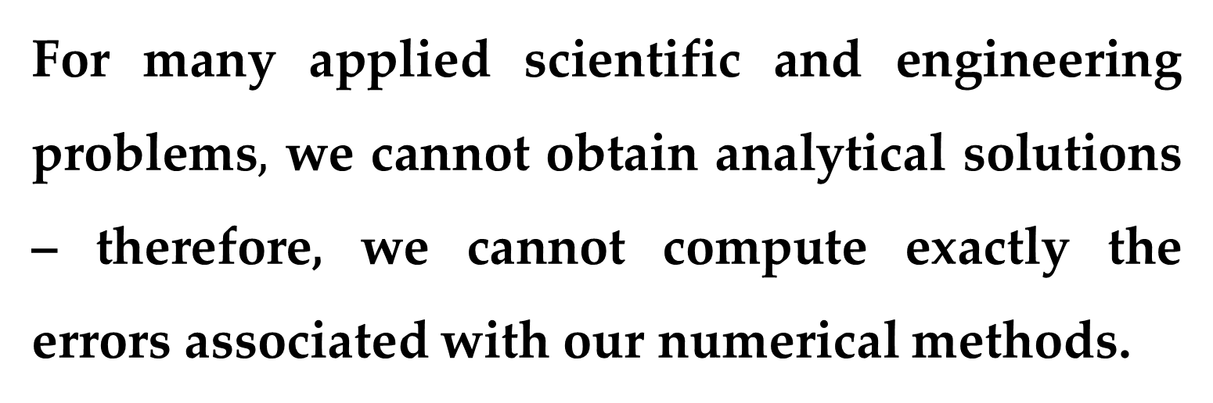
For many applied scientific and engineering problems$,$ we cannot obtain analytical solutions – therefore, we cannot compute exactly the errors associated with our numerical methods.
In these cases, we must settle for approximations or estimates of the errors.
Such errors are characteristic of most of the techniques described in this course.

Slide 7
In professional practice, errors can be costly and sometimes catastrophic.
If a structure or device fails, lives can be lost.
Although perfection is a laudable goal, it is rarely, if ever, attained.
For example, despite the fact that the model developed from Newton’s second law is an excellent approximation, it would never in practice exactly predict the parachutist’s fall.

Slide 8
A variety of factors such as winds and slight variations in air resistance would result in deviations from the prediction.
If these deviations are systematically high or low, then we might need to develop a new model.

Slide 9
However, if these deviations are randomly distributed and tightly grouped around the prediction, then they might be considered negligible and the model deemed adequate.
Numerical approximations also introduce similar discrepancies into the analysis.
Again, the question is: how much error is present in our calculations and is it tolerable?

Slide 10
This lecture covers basic topics related to the identification, quantification, and minimization of these errors.
First, general information concerned with the quantification of error is reviewed in the first sections.
This is followed by a section on one of the two major forms of numerical error: round-off error.

Slide 11
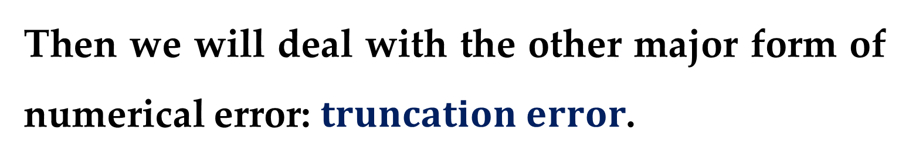
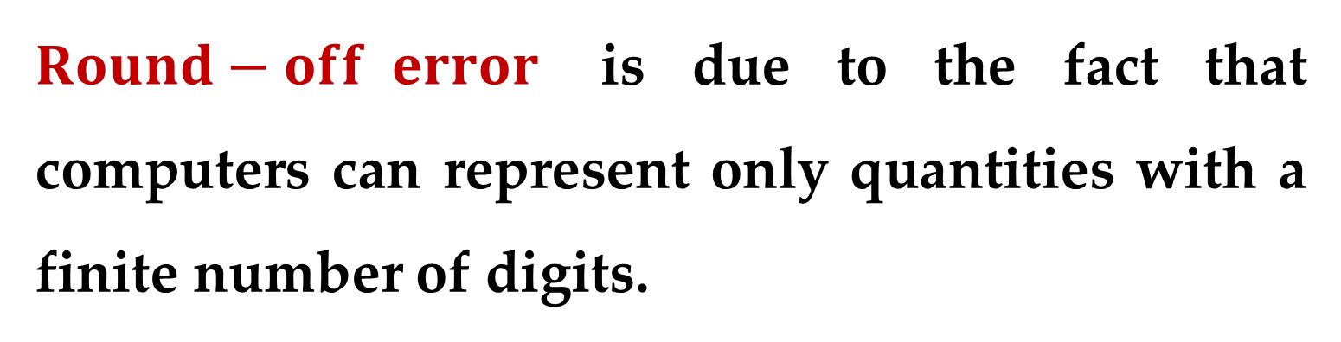
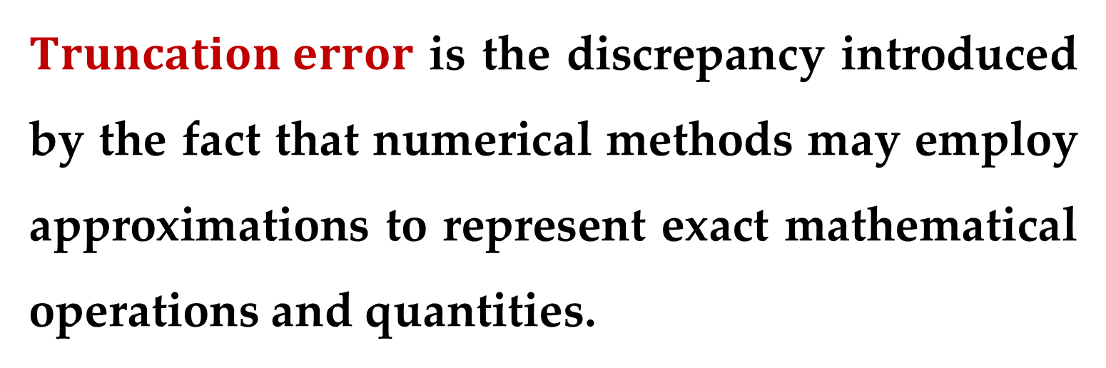
$Round−off error$ is due to the fact that computers can represent only quantities with a finite number of digits.
Then we will deal with the other major form of numerical error: $truncation error$.
$Truncation error$ is the discrepancy introduced by the fact that numerical methods may employ approximations to represent exact mathematical operations and quantities.

Slide 12
Finally, we briefly discuss errors not directly connected with the numerical methods themselves.
These include
blunders,
formulation or model errors,
and data uncertainty.

Slide 13
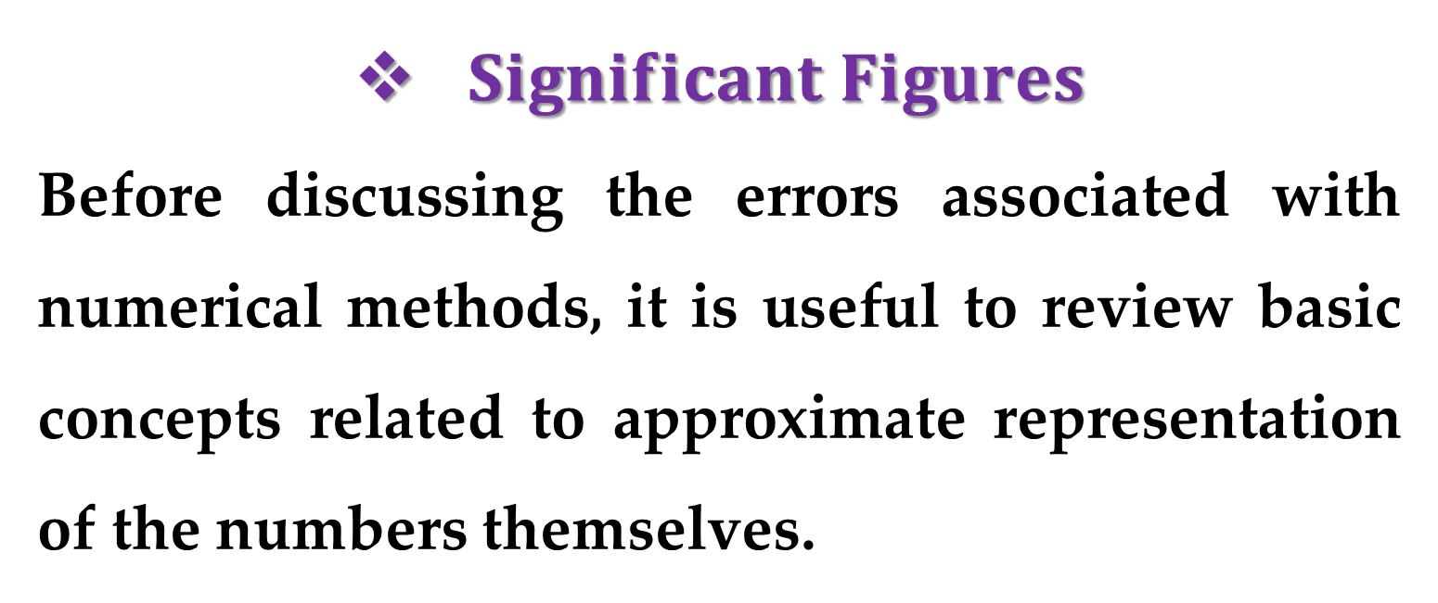
$Significant Figures$
Before discussing the errors associated with numerical methods, it is useful to review basic concepts related to approximate representation of the numbers themselves.
Whenever we employ a number in a computation, we must have assurance that it can be used with confidence.

Slide 14
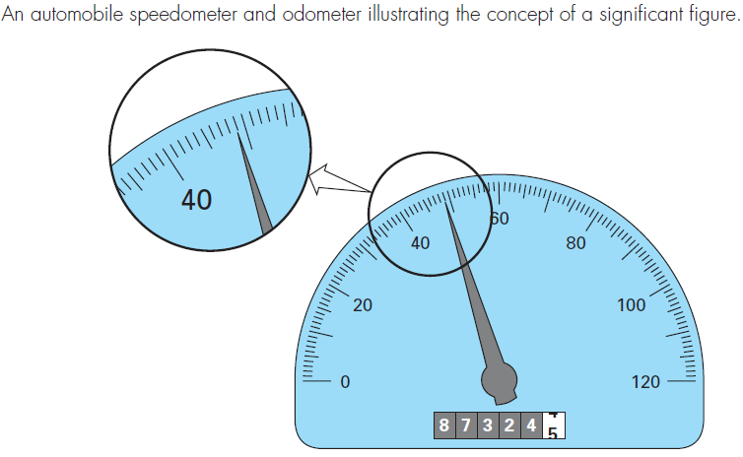
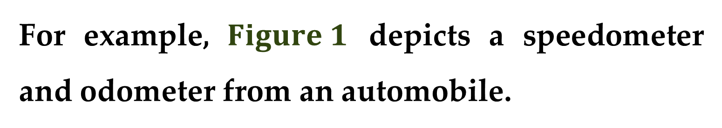
For example, $Figure 1$ depicts a speedometer and odometer from an automobile.
Visual inspection of the speedometer indicates that the car is traveling between 48 and 49 km/h.

Slide 15
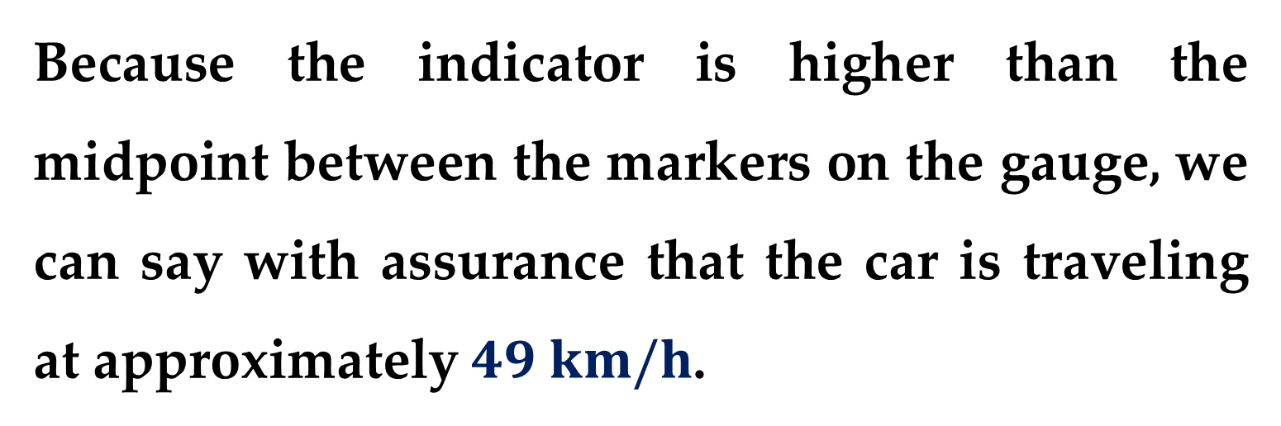
Because the indicator is higher than the midpoint between the markers on the gauge, we can say with assurance that the car is traveling at approximately $49 km/h$.
We have confidence in this result because two or more reasonable individuals reading this gauge would arrive at the same conclusion.

Slide 16
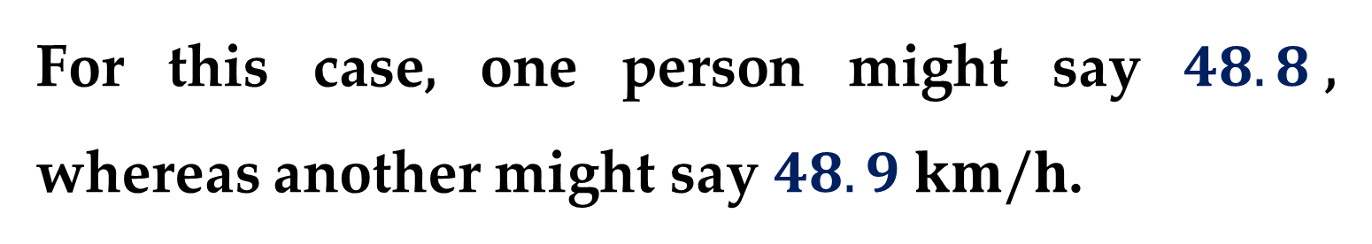
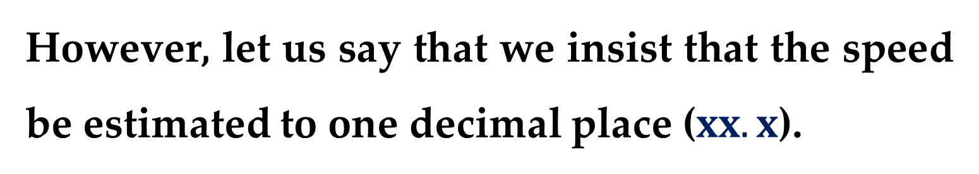
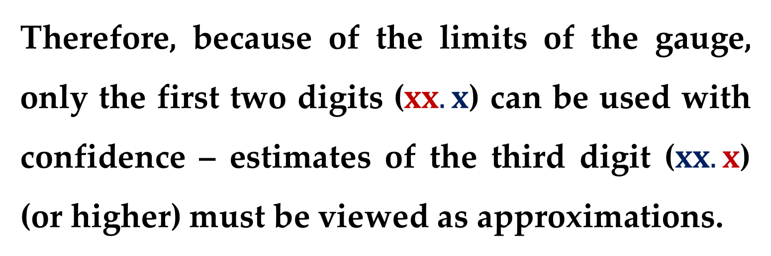
However, let us say that we insist that the speed be estimated to one decimal place ($xx.x$).
For this case, one person might say $48.8$, whereas another might say $48.9 km/h$.
Therefore, because of the limits of the gauge, only the first two digits ($xx.x$) can be used with confidence – estimates of the third digit ($xx.x$) (or higher) must be viewed as approximations.

Slide 17
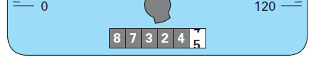
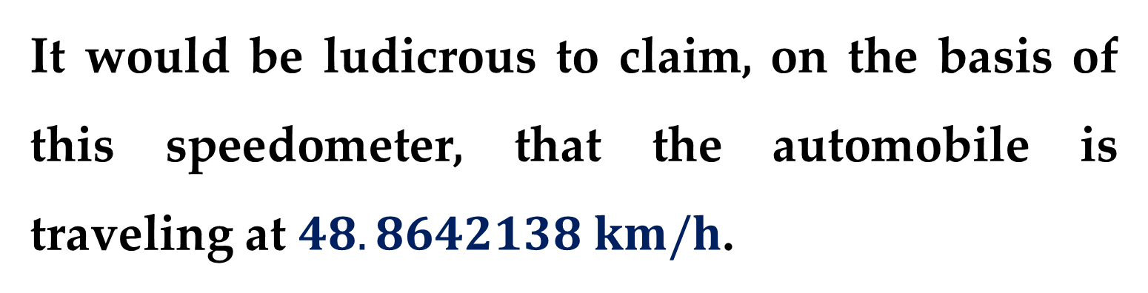
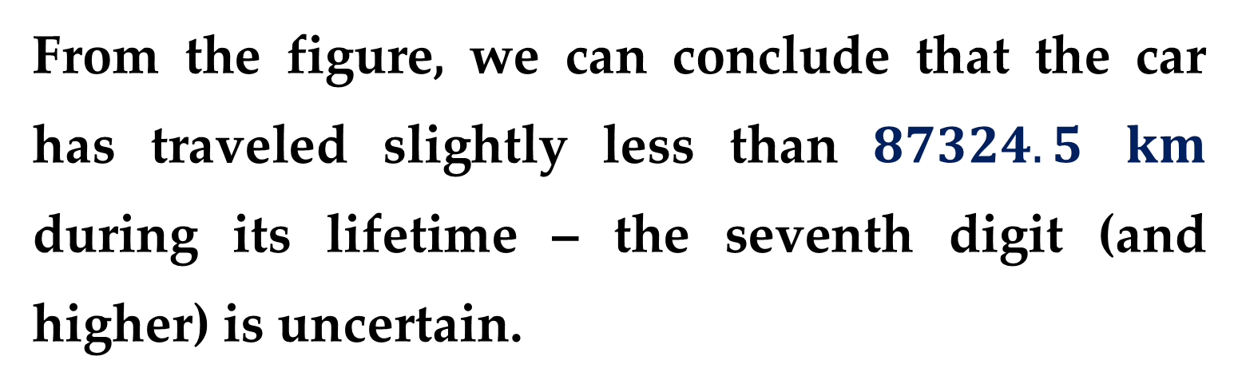
It would be ludicrous to claim, on the basis of this speedometer, that the automobile is traveling at $48.8642138 km/h$.
In contrast, the odometer provides up to six certain digits.
From the figure, we can conclude that the car has traveled slightly less than $87324.5$ $km$ during its lifetime – the seventh digit (and higher) is uncertain.

Slide 18
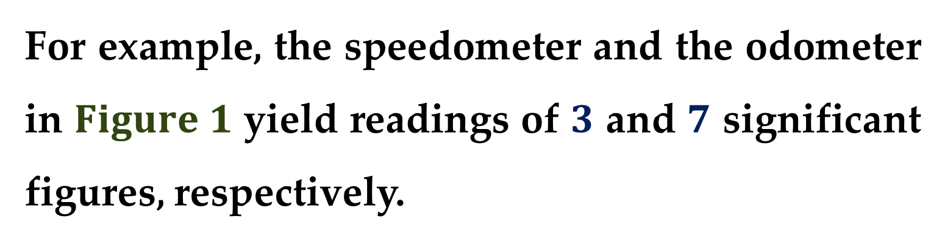
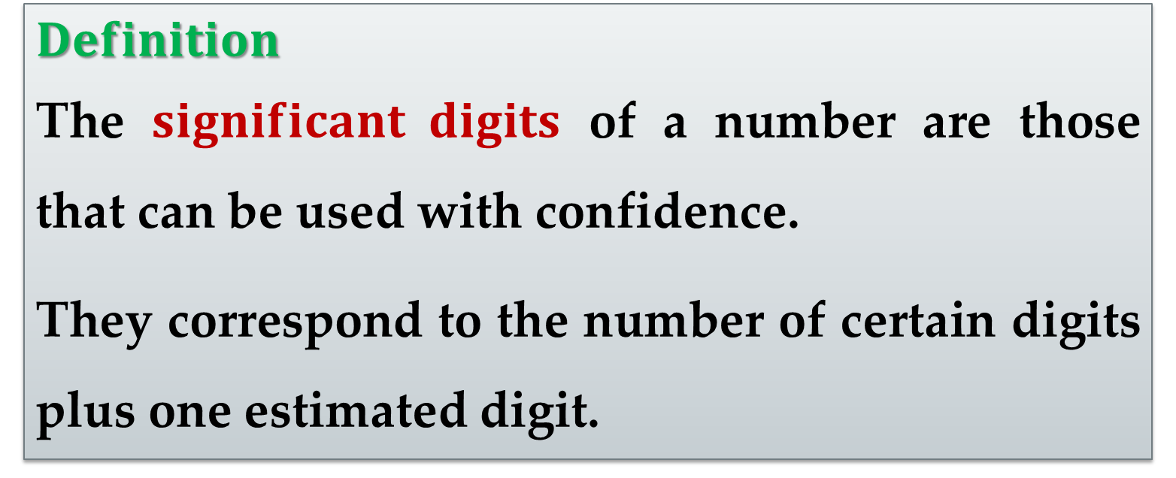
$$Definition$$
The $significant digits$ of a number are those that can be used with confidence.
They correspond to the number of certain digits plus one estimated digit.
For example, the speedometer and the odometer in $Figure 1$ yield readings of $3$ and $7$ significant figures, respectively.

Slide 19
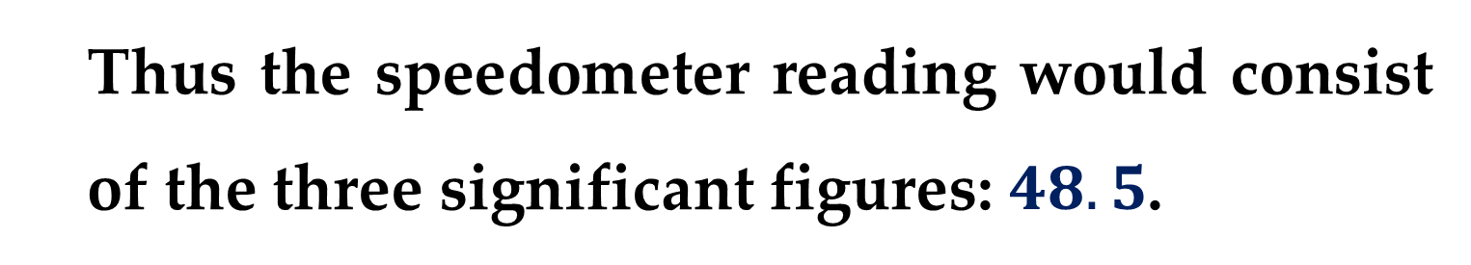
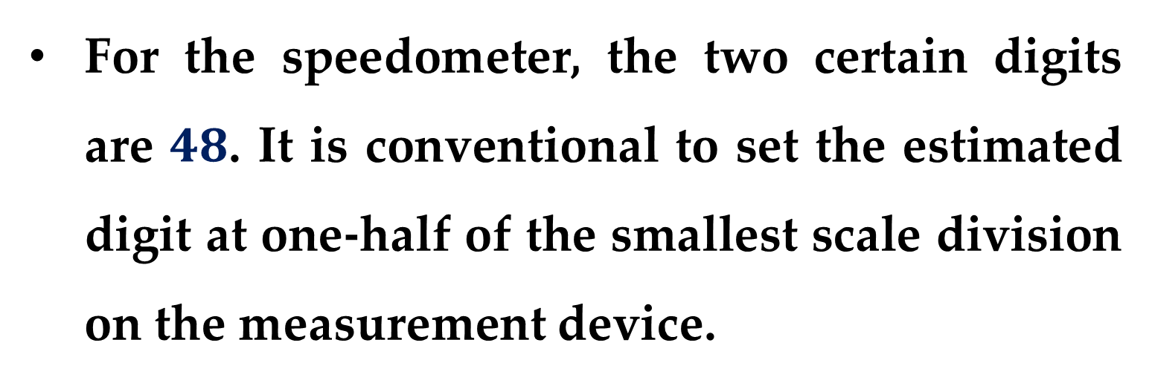
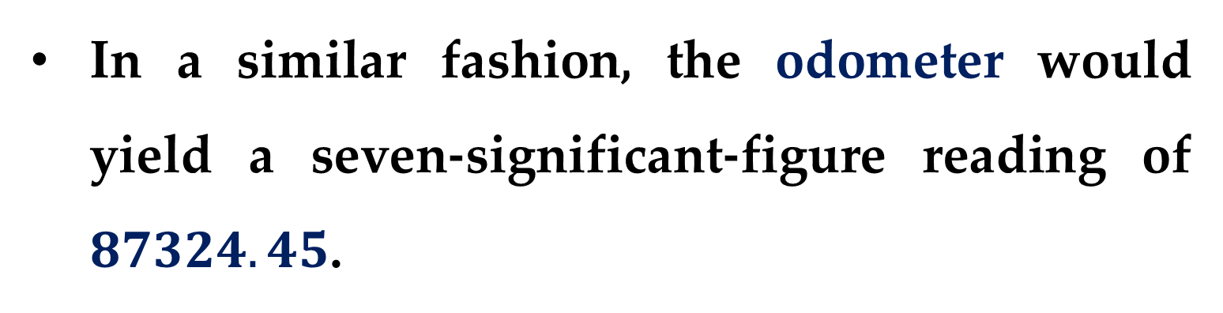
For the speedometer, the two certain digits are $48$. It is conventional to set the estimated digit at one-half of the smallest scale division on the measurement device.
Thus the speedometer reading would consist of the three significant figures: $48.5$.
In a similar fashion, the odometer would yield a seven-significant-figure reading of $87324.45$.

Slide 20
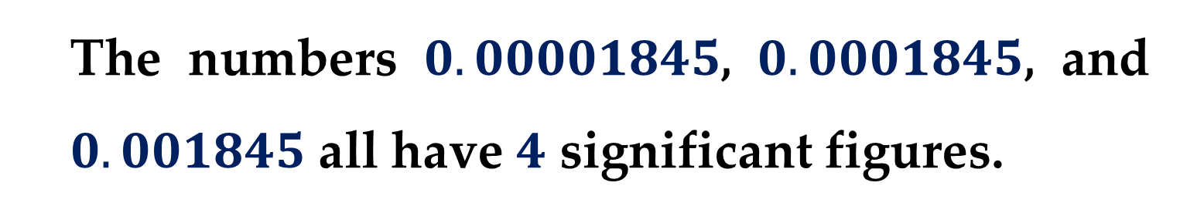
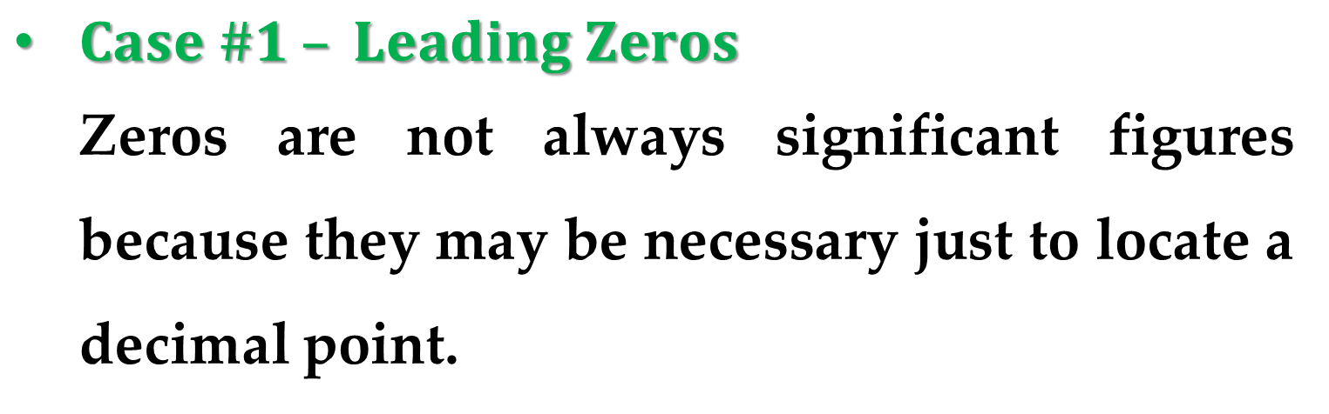
Although it is usually a straightforward procedure to ascertain the significant figures of a number, some cases may lead to confusion.
$Case \#1 – Leading Zeros$
Zeros are not always significant figures because they may be necessary just to locate a decimal point.
The numbers $0.00001845$, $0.0001845$, and $0.001845$ all have $4$ significant figures.

Slide 21
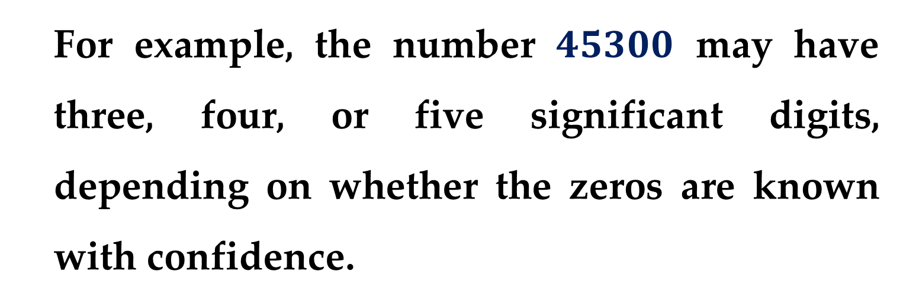
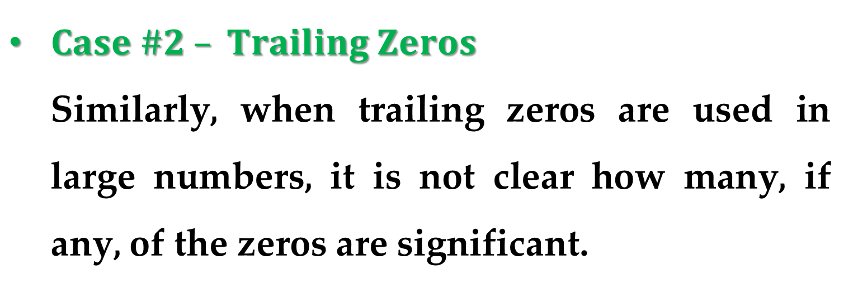
$Case \#2 – Trailing Zeros$
Similarly, when trailing zeros are used in large numbers, it is not clear how many, if any, of the zeros are significant.
For example, the number $45300$ may have three, four, or five significant digits, depending on whether the zeros are known with confidence.

Slide 22
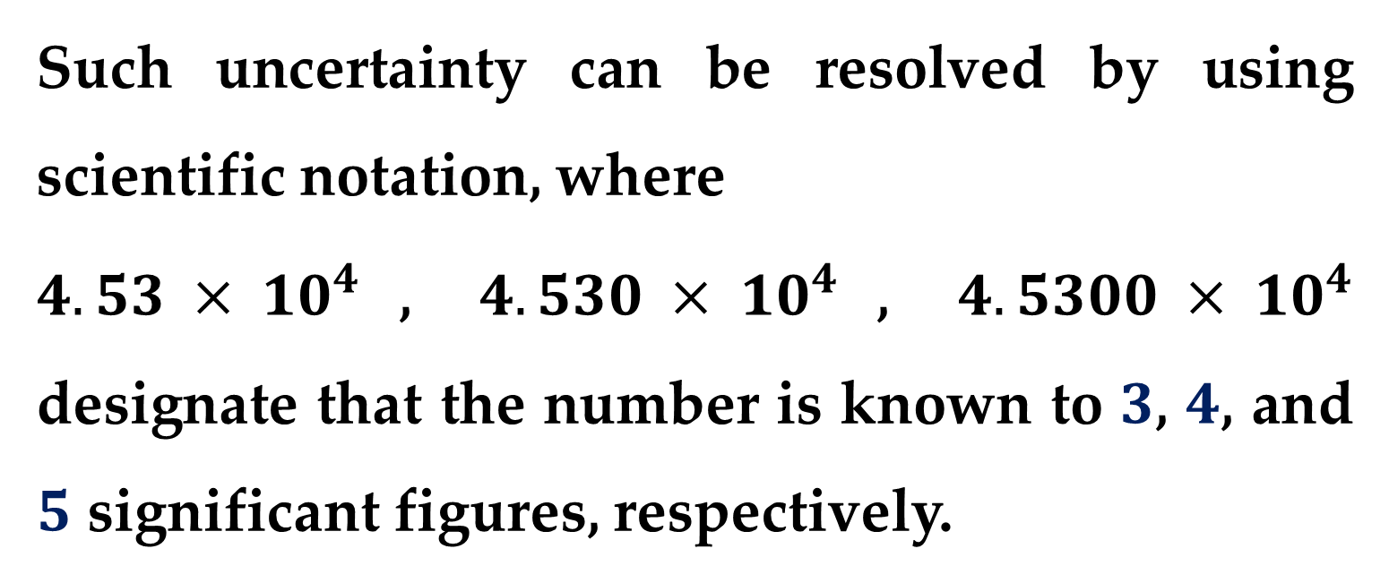
Such uncertainty can be resolved by using scientific notation, where
$4.53 × 10^{4}$, $4.530 × 10^{4}$, $4.5300 × 10^{4}$ designate that the number is known to $3$, $4$, and $5$ significant figures, respectively.

Slide 23
The concept of significant figures has two important implications for our study of numerical methods:
As introduced in the falling parachutist problem, numerical methods yield only approximate results.
We must, therefore, develop a criteria to specify how confident we are in our approximate result.

Slide 24
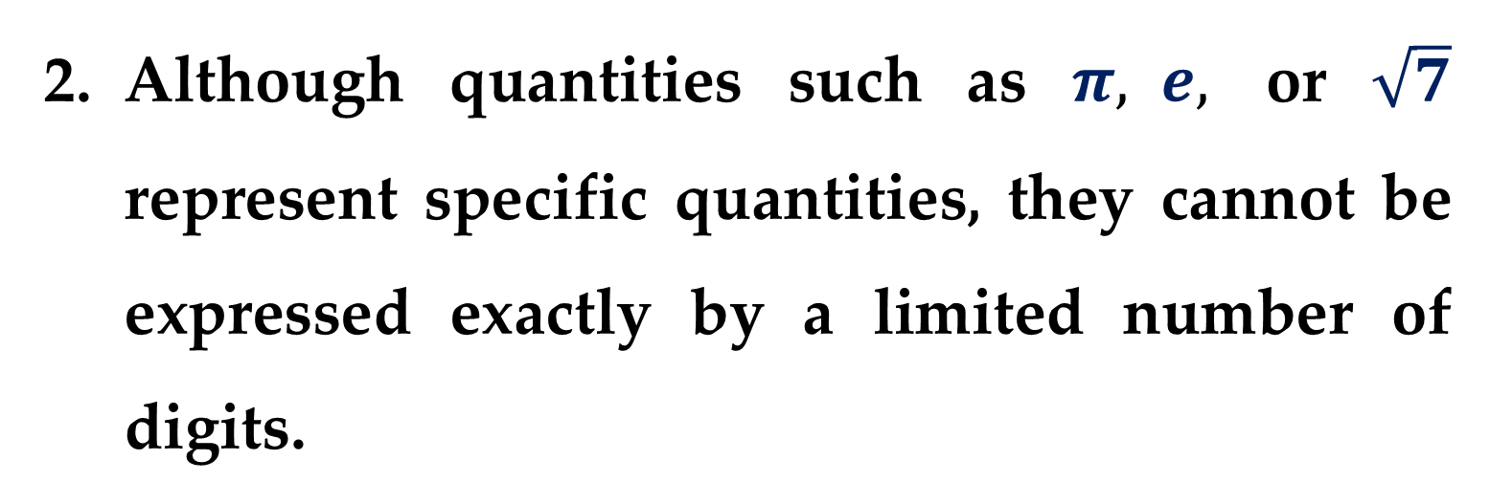
One way to do this is in terms of significant figures.
For example, we might decide that our approximation is acceptable if it is correct to four significant figures.
Although quantities such as $π, e,$ or $\sqrt{7}$ represent specific quantities, they cannot be expressed exactly by a limited number of digits.

Slide 25
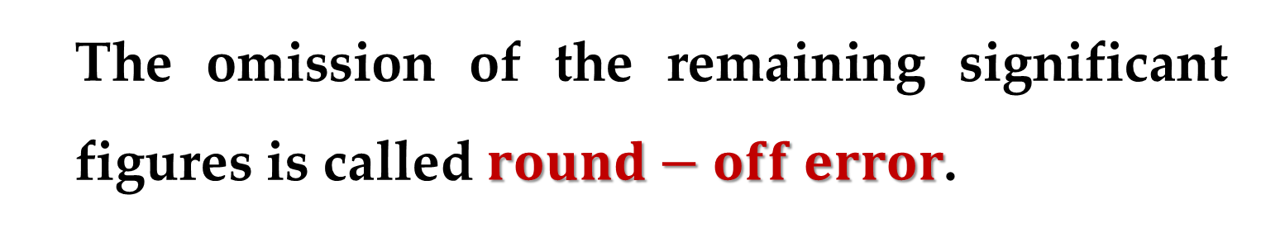
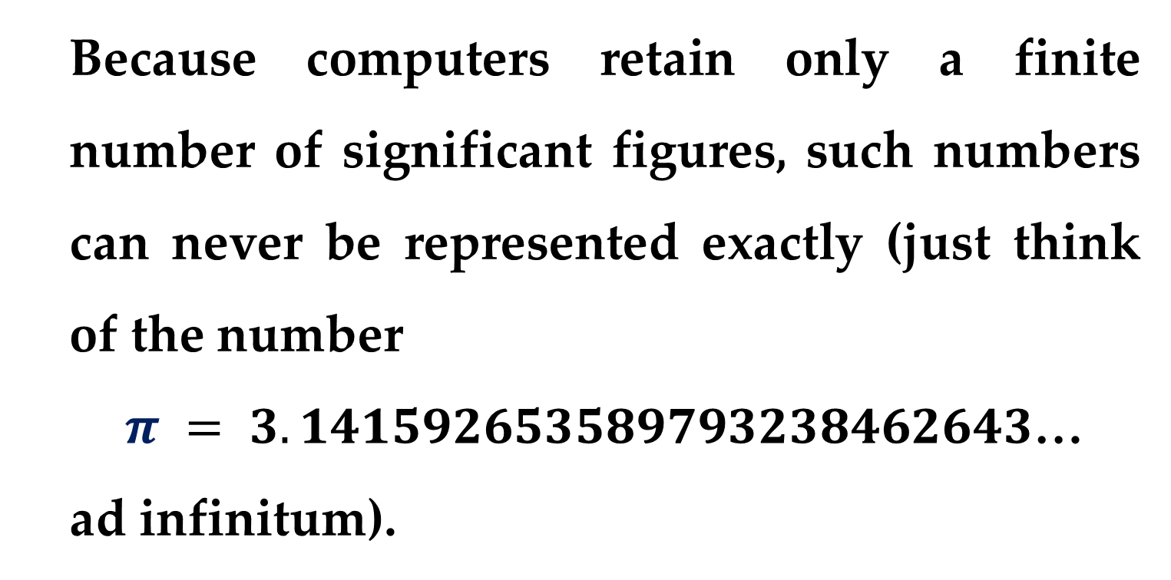
Because computers retain only a finite number of significant figures, such numbers can never be represented exactly (just think of the number
$π = 3.141592653589793238462643$…
ad infinitum).
The omission of the remaining significant figures is called $round−off error$.

Slide 26
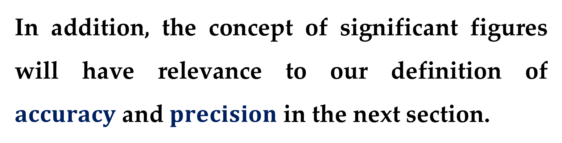
Both round-off error and the use of significant figures to express our confidence in a numerical result will be explored in detail in subsequent sections.
In addition, the concept of significant figures will have relevance to our definition of $accuracy$ and $precision$ in the next section.

Slide 27
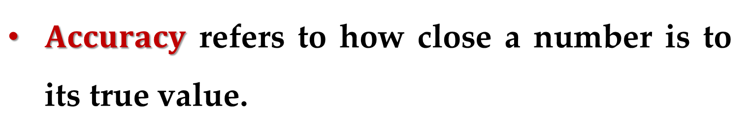
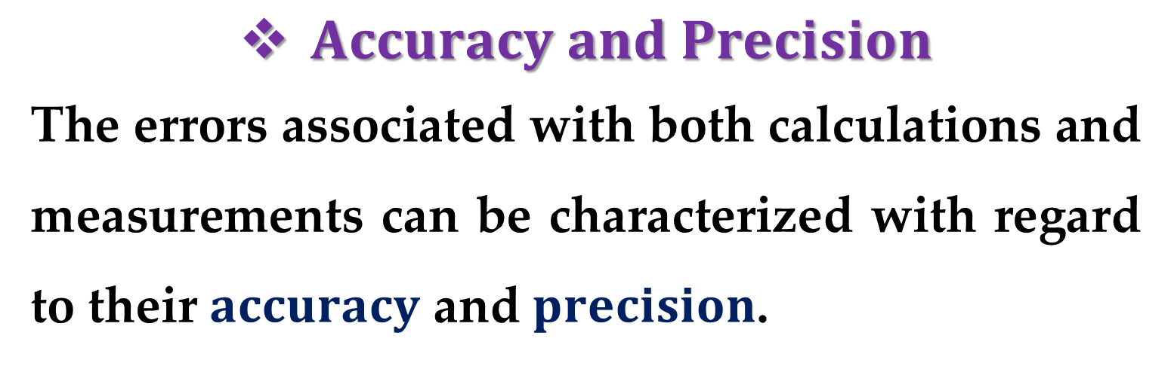
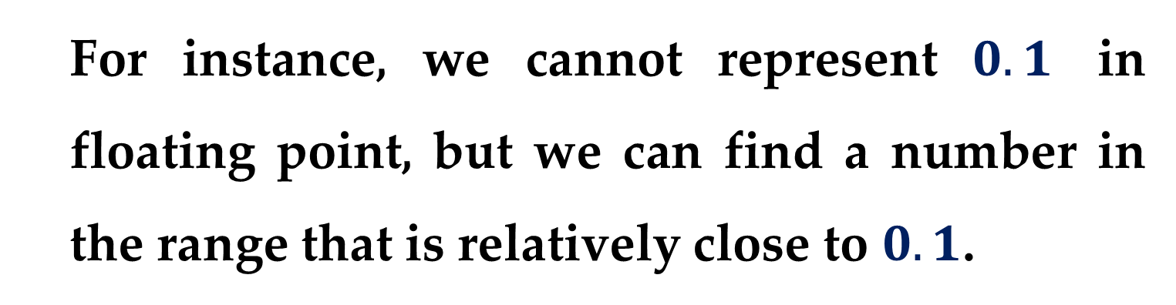
$Accuracy and Precision$
The errors associated with both calculations and measurements can be characterized with regard to their $accuracy$ and $precision$.
$Accuracy$ refers to how close a number is to its true value.
For instance, we cannot represent $0.1$ in floating point, but we can find a number in the range that is relatively close to $0.1$.

Slide 28
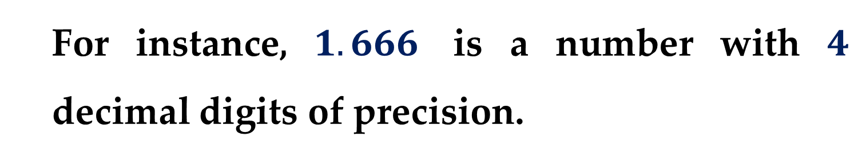
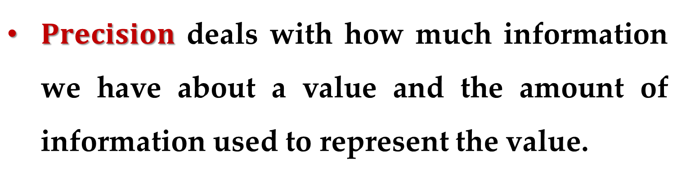
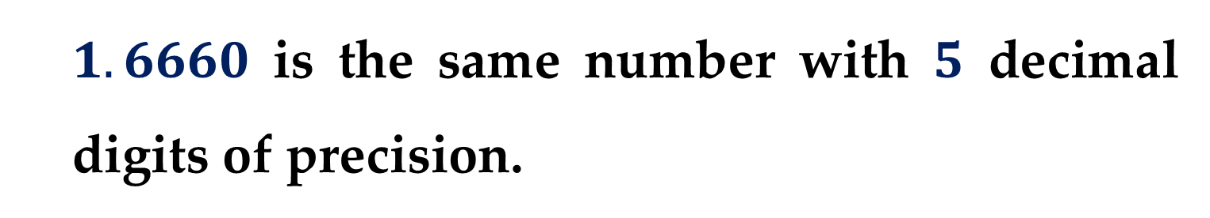
$Precision$ deals with how much information we have about a value and the amount of information used to represent the value.
For instance, $1.666$ is a number with $4$ decimal digits of precision.
$1.6660$ is the same number with $5$ decimal digits of precision.

Slide 29
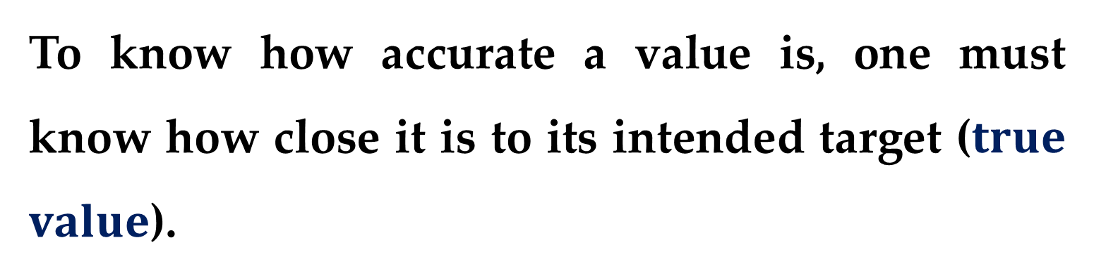
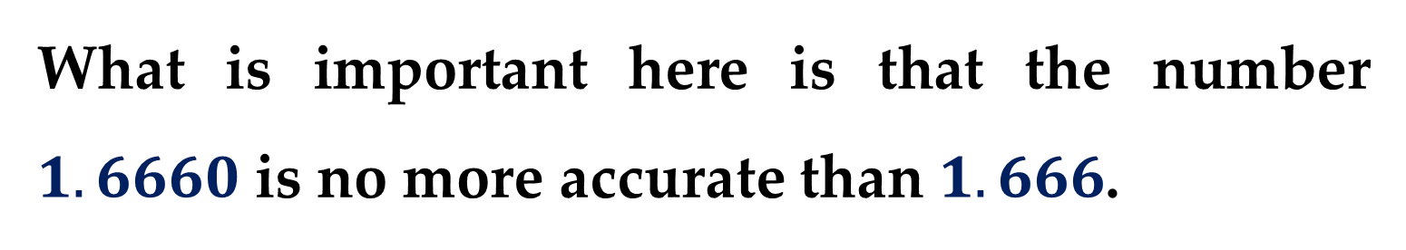
What is important here is that the number $1.6660$ is no more accurate than $1.666$.
To know how accurate a value is, one must know how close it is to its intended target ($true$ $value$).
We cannot just look at two numbers and immediately declare that the first is more accurate than the second simply because the first number has more digits of precision.

Slide 30
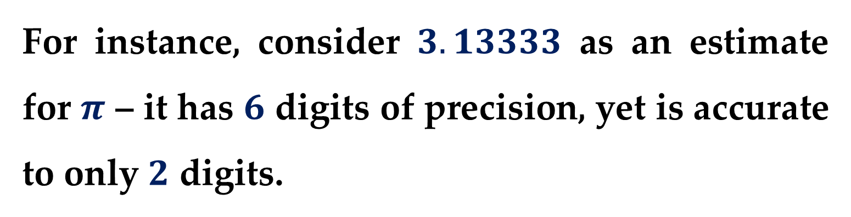
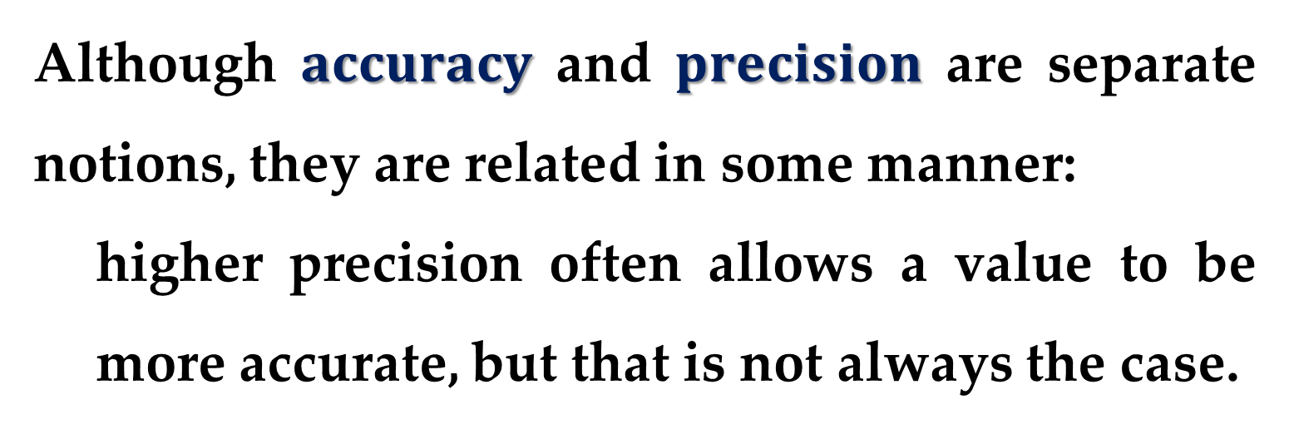
For instance, consider $3.13333$ as an estimate for $π$ – it has $6$ digits of precision, yet is accurate to only $2$ digits.
Adding more precision will do nothing to increase the accuracy.
Although $accuracy$ and $precision$ are separate notions, they are related in some manner:
higher precision often allows a value to be more accurate, but that is not always the case.

Slide 31
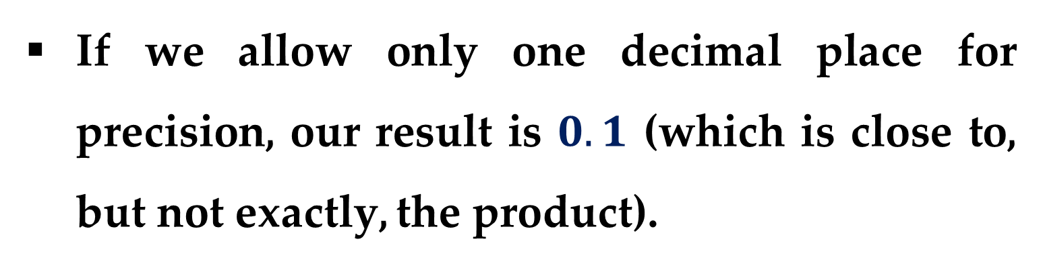
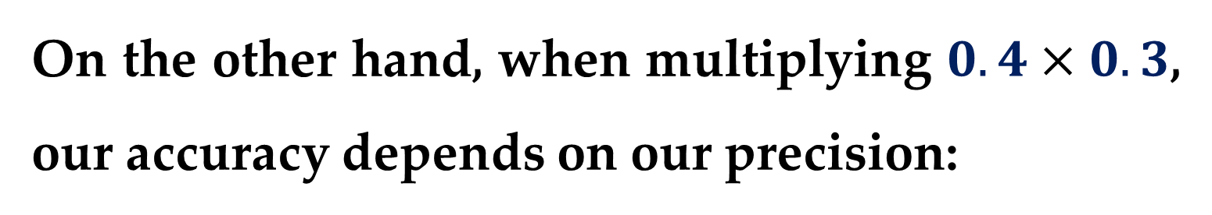
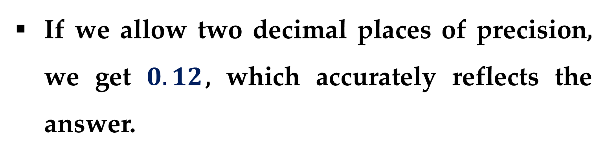
On the other hand, when multiplying $0.4×0.3$, our accuracy depends on our precision:
If we allow only one decimal place for precision, our result is $0.1$ (which is close to, but not exactly, the product).
If we allow two decimal places of precision, we get $0.12$, which accurately reflects the answer.

Slide 32
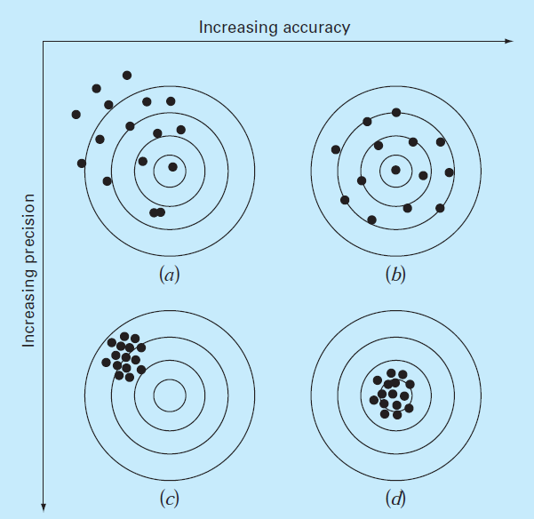
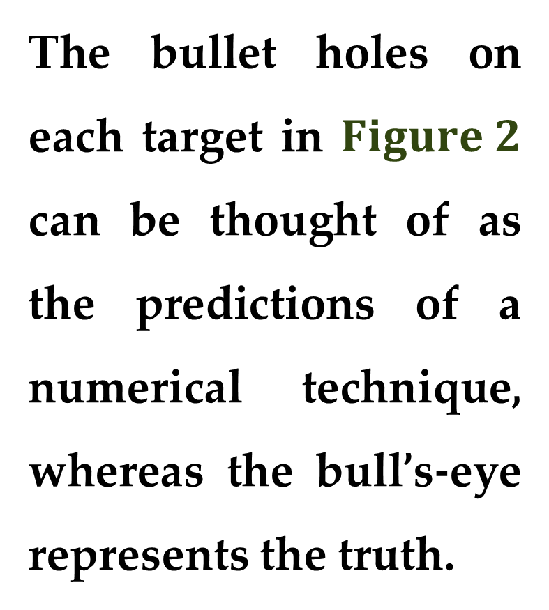
These concepts can be illustrated graphically using an analogy from target practice.
The bullet holes on each target in $Figure 2$ can be thought of as the predictions of a numerical technique, whereas the bull’s-eye represents the truth.

Slide 33
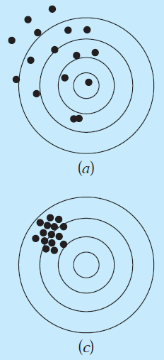
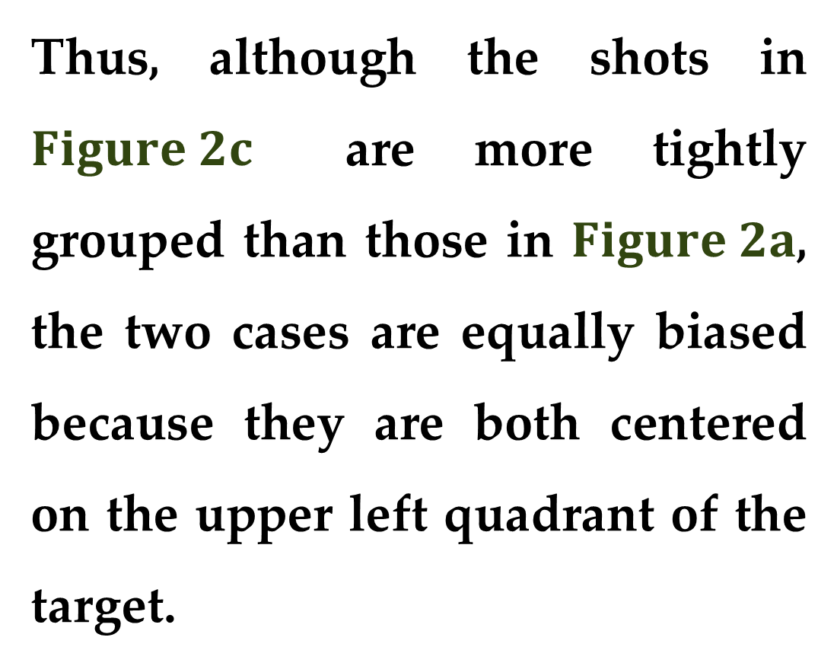
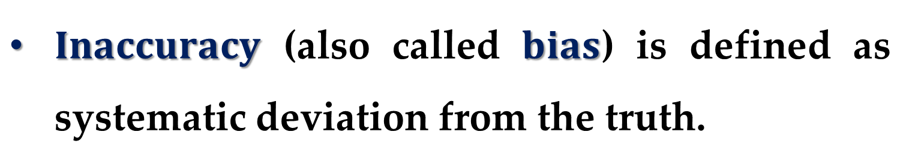
$Inaccuracy$ (also called $bias$) is defined as systematic deviation from the truth.
Thus, although the shots in $Figure 2c$ are more tightly grouped than those in $Figure 2a$, the two cases are equally biased because they are both centered on the upper left quadrant of the target.

Slide 34



$Imprecision$ (also called $uncertainty$) refers to the magnitude of the scatter.
Therefore, although $Figure 2b$ and $Figure 2d$ are equally accurate (centered on the bull’s-eye), the latter is more precise because the shots are tightly grouped.

Slide 35


$$Requirements for Numerical Methods$$
Numerical methods should be sufficiently $accurate$or unbiased to meet the requirements of a particular scientific or engineering problem.
They also should be $precise$ enough for adequate scientific or engineering design.*

Slide 36

$Error Definitions$
We will use the collective term $error$ to represent both the inaccuracy and the imprecision of our predictions.
With these concepts as background, we can now discuss the factors that contribute to the error of numerical computations.

Slide 37


Numerical errors arise from the use of approximations to represent exact mathematical operations and quantities.
$Truncation errors$
result when approximations are used to represent exact mathematical procedures.
$Round−off errors$ result when numbers having limited significant figures are used to represent exact numbers.

Slide 38


For both types, the relationship between the exact (true) result and the approximation can be formulated as
$true_value = approximation + error$ $\left(1\right)$
By rearranging equation $(1),$ we find that the numerical error is equal to the discrepancy between the truth and the approximation, as in
$E_{t}=true_value − approximation$ $\left(2\right)$

Slide 39
A shortcoming of this definition is that it takes no account of the order of magnitude of the value under examination.
For instance, an error of a centimeter is much more significant if we are measuring the size of a bolt rather than a bridge.

Slide 40


One way to account for the magnitudes of the quantities being evaluated is to normalize the error to the true value, as in
$$true_fractional_relative_error=\frac{\text{true}\text{_}\text{error}}{\text{true}\text{_}\text{value}}$$
The relative error can also be multiplied by $100$ to express it in percent as follows
$ε_{t}=\frac{\text{true}\text{_}\text{error}}{\text{true}\text{_}\text{value}}×100\%$ $\left(3\right)$

Slide 41


$$Example 1. Calculation of Errors$$
Suppose that you have the task of measuring the lengths of a bridge and a bolt and come up with $9999$ and $9$ cm, respectively.
If the true values are $10000$ and $10$ cm, respectively, compute
$(a)$the true error;
$(b)$ the true percent relative error;
for each case.

Slide 42



Solution
$(a)$ The error for measuring the bridge is
$$E_{t}=10000−9999=1 cm$$
and for the bolt it is
$$E_{t}=10−9=1 cm$$
$(b)$ The percent relative errors for the bridge and bolt are$,$ respectively
$ε_{t}=\frac{1}{10000}100\%=0.01\%, ε_{t}=\frac{1}{10}100\%=10\%$

Slide 43

Solution (continued)
Thus, although both measurements have an error of $1$ cm, the relative error for the bolt is much greater.
We would conclude that we have done an adequate job of measuring the bridge, whereas our estimate for the bolt leaves something to be desired.

Slide 44


$$Remark$$
Notice that for Eqs. $(2)$ and $(3)$, $E$ and $ε$ are subscripted with an index $t$ to signify that the error is normalized to the true value.
In $Example 1$, we were provided with this value.
However, in actual situations such information is rarely available.

Slide 45
For numerical methods, the true value will be known only when we deal with functions that can be solved analytically.
Such will typically be the case when we investigate the theoretical behavior of a particular technique for simple systems.
However, in real-world applications, we will obviously not know the true answer a priori.

Slide 46


For these situations, an alternative is to normalize the error using the best available estimate of the true value, i.e. the approximation itself, as in
$ε_{a}=\frac{\text{approximate}\text{_}\text{error}}{\text{approximation}}×100\%$ $\left(4\right)$
Note also that for real-world applications, Eq. $\left(2\right)$ cannot be used to calculate the error term for Eq. $\left(4\right)$.

Slide 47

One of the challenges of numerical methods is to determine error estimates in the absence of knowledge regarding the true value.
For instance, certain numerical methods use an $iterative approach$ to compute answers.
In such an approach, a present approximation is made on the basis of a previous approximation.

Slide 48

This process is performed repeatedly, or iteratively, to successively compute (hopefully) better and better approximations.
For such cases, the error is often estimated as the difference between previous and current approximations. Thus, percent relative error is determined according to
$ε_{a}=\frac{current_{apr.} − previous_{apr}. }{current_{apr.}}×100\%$ $\left(5\right)$

Slide 49


$$Note$$
The signs of Eqs. $(2)$ through $(5)$ may be either positive or negative (either because of numerator or denominator).
Often, when performing computations, we may not be concerned with the sign of the error, but we are interested in whether the percent absolute value is lower than a prescribed percent tolerance $ε_{s}$.

Slide 50


Therefore, it is often useful to employ the absolute value of Eqs. $(2)$ through $(5)$.
For such cases, the computation is repeated until
$\left|ε_{a}\right|<ε_{s}$ $\left(6\right)$
If this relationship holds, our result is assumed to be within the prescribed acceptable level $ε_{s}$.

Slide 51

It is also convenient to relate these errors to the number of significant figures in the approximation.
It can be shown [see Scarborough. Numerical Mathematical Analysis, 1966] that if the following criterion is met, we can be assured that the result is correct to at least $n$ significant figures
$ε_{s}=\left(0.5×10^{2−n}\right)\%$ $\left(7\right)$

Slide 52


$Example 2. Error Estimates for Iterative$ $Methods$
In mathematics, functions can often be approximated by infinite series.
For instance, the exponential function can be computed using (for some integer $n$)
$$e^{x}≅1+x+\frac{x^{2}}{2!}+\frac{x^{3}}{3!}+…+\frac{x^{n}}{n!} \left(8\right)$$

Slide 53



$$Example 2. \left(continued\right)$$
Thus, as more terms are added in the sequence, the approximation becomes a better and better estimate of the true value of $e^{x}$.
Starting with the simplest version, $e^{x}=1$, add terms one at a time to estimate $e^{0.5}$.
After each new term is added, compute the true and approximate percent relative errors with equations $(3)$ and $(5),$ respectively.

Slide 54


$$Example 2. \left(continued\right)$$
Add terms until the absolute value of the approximate error estimate $ε_{a}$ falls below a prescribed error criterion $ε_{s}$ conforming to three significant figures.
$$Solution$$
First$,$ Eq. $(7)$ can be employed to determine the error criterion that ensures a result is correct to at least three significant figures.

Slide 55



$$Solution (continued)$$
Thus
$$ε_{s}=\left(0.5×10^{2−3}\right)\%=0.05\%$$
Thus$,$ we will add terms to the series until $ε_{a}$ falls below this level.
The first estimate is simply equal to Eq. $(8)$ with a single term – that is$,$ it is equal to $1$.

Slide 56


$$Solution (continued)$$
The second estimate is then generated by adding the second term$,$ as in
$$e^{x}=1+x$$
or, for $x=0.5$,
$$e^{0.5}=1+0.5=1.5$$
This represents a true percent relative error of
$$ε_{t}=\frac{1.648721−1.5}{1.648721}×100\%=9.02\%$$

Slide 57


$$Solution (continued)$$
Equation $\left(5\right)$ can be used to determine an approximate estimate of the error$,$ as in
$$ε_{a}=\frac{1.5−1}{1.5}×100\%=33.3\%$$
Because $ε_{a}$ is not less than the required value of $ε_{s},$ we would continue the computation by adding another term$,$ $x^{2}/2!,$ and repeating the error calculations.

Slide 58


$$Solution (continued)$$
The process should be continued until $ε_{a}<ε_{s}$.
The entire computation can be summarized as follows ($Figure 3$):

Slide 59


$$Solution (continued)$$
Thus, after six terms are included, the approximate error falls below the threshold $ε_{s}$ and the computation can be terminated.
However, notice that, rather than three significant figures, the result is accurate to five.
This is because$,$ for this case$,$ both Eqs. $\left(5\right)$ and $\left(7\right)$ are $conservative$.

Slide 60


$$Solution (continued)$$
That is$,$ they ensure that the result is at least as good as they specify.
Although this is not always the case for Eq. $\left(5\right),$ it is true most of the time.

Slide 61

$Computer Algorithm for Iterative$ $Calculations$
Many of the numerical methods to be described in this course involve iterative calculations of the sort illustrated in $Example 2$.
They all entail solving a mathematical problem by computing successive approximations to the solution starting from an initial guess.

Slide 62

The computer implementation of such iterative solutions involves loops.
These come in two basic flavors:
count-controlled loops;
decision loops.
But rather than employing a prescribed number of iterations, the process typically is repeated until an approximate error estimate falls below a stopping criterion (as in $Example 2$).

Slide 63



A pseudocode for a generic iterative
calculation is presented in
$Figure 4$.
The function is passed a value ($val$) along with a stopping error criterion ($es$) and a maximum allowable number of iterations ($maxit$).*

Slide 64


The $val$ is typically either
an initial value;
the value for which the iterative calculation is to be made.
The function first initializes three variables.
These include
a variable $iter$ that keeps track of the number of iterations;

Slide 65



a variable $sol$ that holds the current estimate of the solution;
a variable $ea$ that holds the approximate percent relative error.
Note that $ea$ is initially set to a value of $100$ to ensure that the loop executes at least once.

Slide 66


These initializations are followed by the decision loop that actually implements the iterative calculation.
Prior to generating a new solution, $sol$ is first assigned to $solold$.
Then a new value of $sol$ is computed and the iteration counter is incremented.

Slide 67

If the new value of $sol$ is nonzero, the percent relative error $ea$ is determined.
The stopping criteria are then tested:
If both are false, the loop repeats;
If either are true, the loop terminates and the final solution is sent back to the function call.

Slide 68

The following example illustrates how the generic algorithm can be applied to a specific iterative calculation.
$Example 3$. $Computer Implementation of an$
$$Iterative Calculation$$
Develop a computer program (both in $Matlab$ and $Excel$) based on the pseudocode from $Figure 4$ to implement the calculation from $Example 2$. $∗∗∗$

Slide 69
Thank you for attention

Slide 70
text
text
text

